Slide 1

PROJECT PRESENTATION
Presentation by:
SHARON.K

Slide 2
OUTLINE
ABSTRACT
MODULE IMPLEMENTATION
MODULE SCREENSHOTS
DATABASE ER DIAGRAM
TABLES
OPTIONAL CLASS DIAGRAM
TESTING
FUTURE ENHANCEMENT

Slide 3
ABSTRACT
Ecommerce has become the most dominant use of internet for many, from Electronics, groceries, furnitures to food delivery and even entire automobile business have gone online, providing access to products from all around the world to users on a computer with a single button click.
Electronic Commerce is process of doing business through computer networks, that involves the transfer of information across the Internet. A person sitting on his chair in front of a computer can access all the facilities of the Internet to buy or sell the products.It is an online website that enables website owners to sell their products whereas the customers will buy the products.

Slide 4
IMPLEMENTATION MODULES
Backend
Frontend
Testing
Db Config class
Controller
class
Jsp files
Entity
class
DAO Interface
DAO Impl

Slide 5

MODULE SCREENSHOT

Slide 6
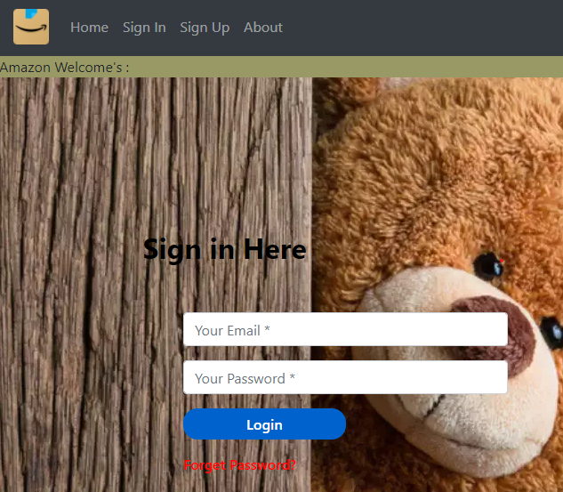
MODULE SCREENSHOT

Slide 7
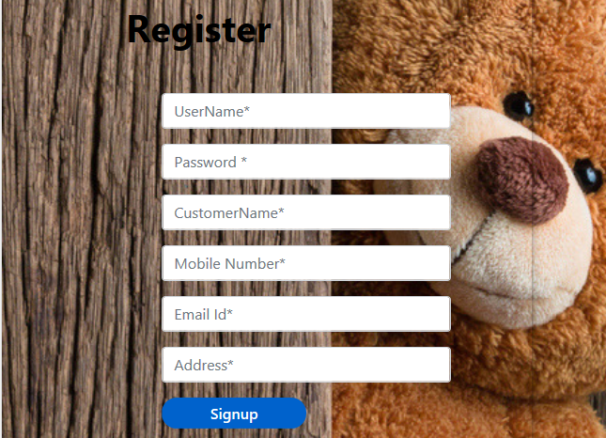
MODULE SCREENSHOT

Slide 8

MODULE SCREENSHOT

Slide 9
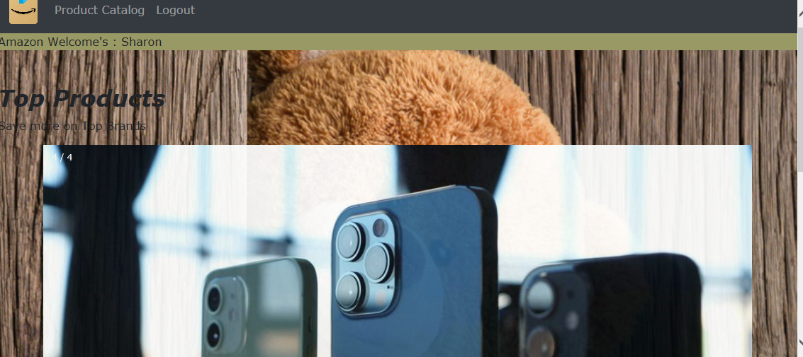
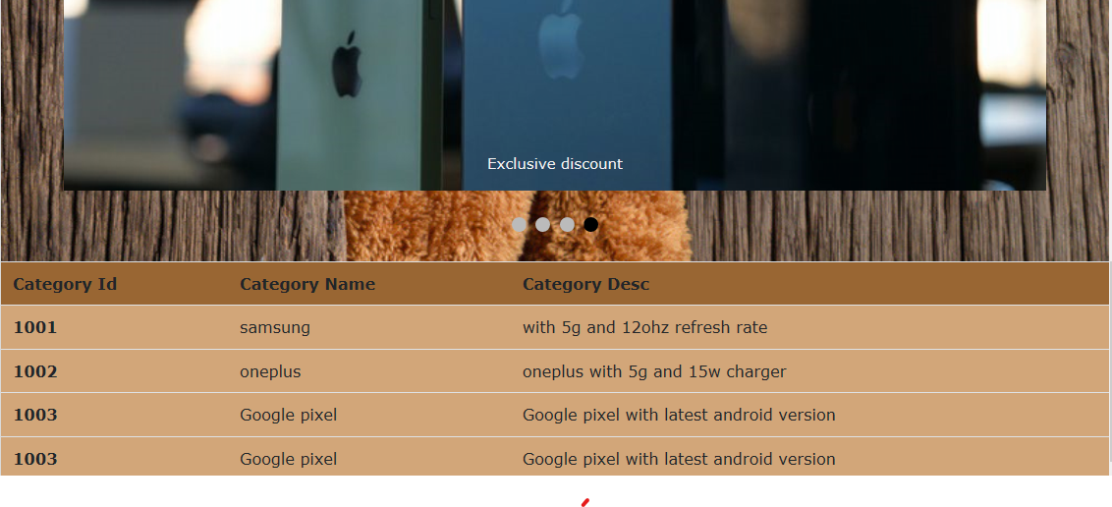
MODULE SCREENSHOT

Slide 10

MODULE SCREENSHOT

Slide 11
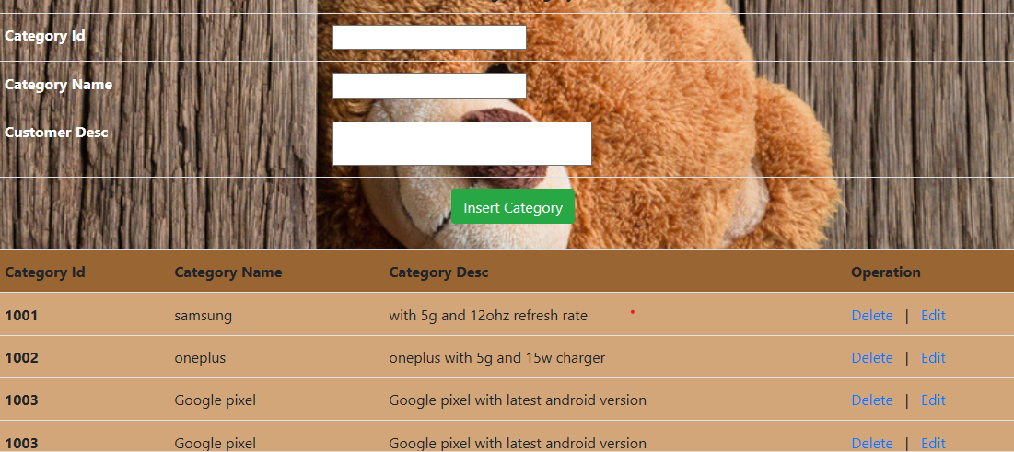
MODULE SCREENSHOT

Slide 12
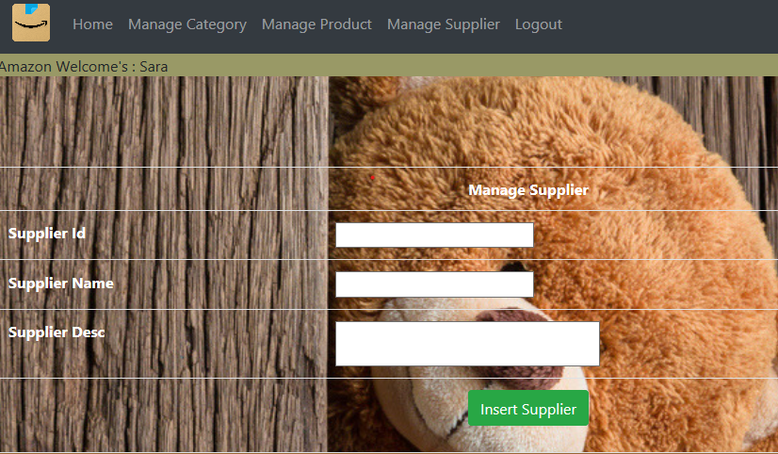
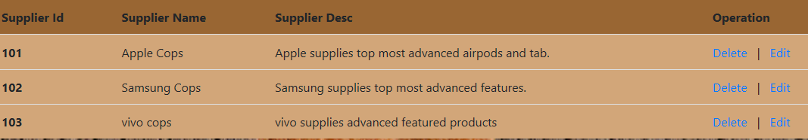
MODULE SCREENSHOT

Slide 13
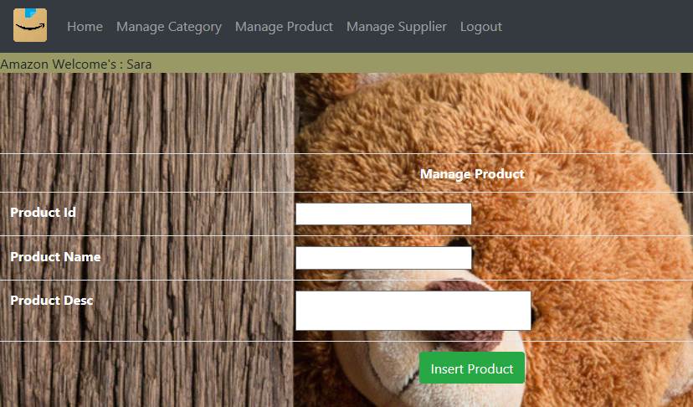
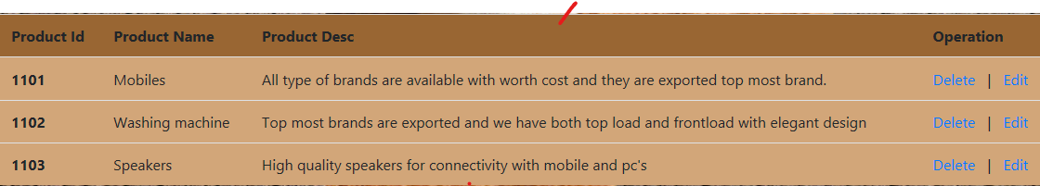
MODULE SCREENSHOT

Slide 14
MODULE SCREENSHOT

Slide 15
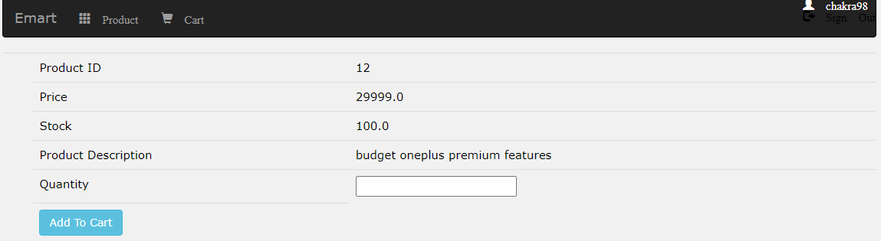
MODULE SCREENSHOT

Slide 16
DATABASE ER DIAGRAM
Sign in
Role
Admin
User
Username
password
Product
Product catalog
supplier
Category
pro desc
sup id
Sup desc
Pro name
Cat id
Cat name
Cat desc
sup name
pro id

Slide 17
TABLES
Userdetail Table:
Product Table:

Slide 18
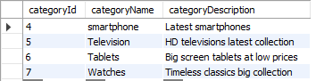
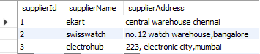
Category Table:
Supplier Table:

Slide 19
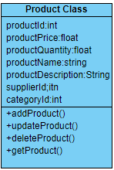
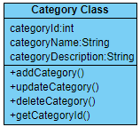
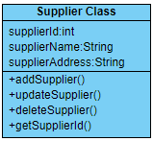
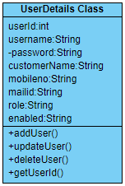
OPTIONAL CLASS DIAGRAM

Slide 20
TESTING
UNIT TESTING is a type of software testing where individual units or components of a software are tested. The purpose is to validate that each unit of the software code performs as expected.
Unit testing finds problems early in the development cycle. This includes both bugs in the programmer's implementation and flaws or missing parts of the specification for the unit.

Slide 21
FUTURE ENHANCEMENT
Addition of 2 factor authentication for increased security
Live tracking of products along with sms and email alerts
Product review and discussion forum to enable customers to have more transparency in their purchase
Browsing history based suggestion for users for better visibility of product of interest.

Slide 22
THANK YOU

